Slide 1
Pattern Partner: Modern interface for a classic craft
Sebastian Greenholtz
Honors Project, Spring 2016

Slide 2
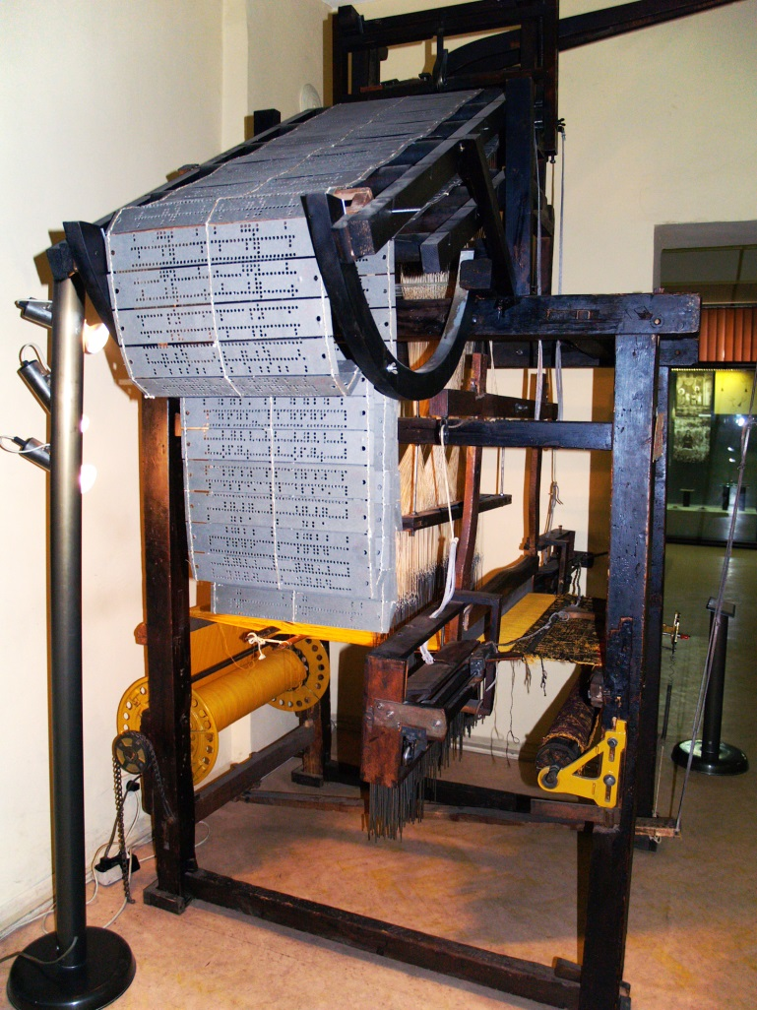
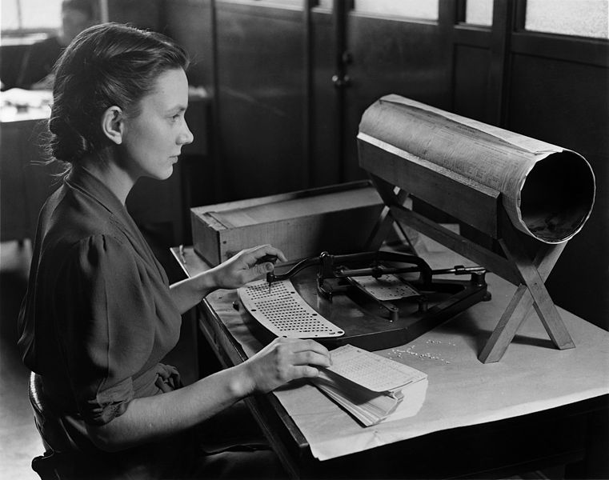
Where it all began
Hollerith Tabulation Machine
Jacquard Loom, end of 19th C
Notes:
In 1801 French weaver Joseph Marie Jacquard first demonstrated a revolutionary new technology in the world of textiles: a loom that used cards with punches in a specific sequence, strung together in a continuous sequence to create complex patterns. Almost a century later, American inventor Herman Hollerith used the same idea to create a punch card tabulation machine to input data for the 1890 US Census. Six years later, Hollerith founded the Tabulation Machine Company to develop the punch card tabulation machine for industrial usage.

Slide 3

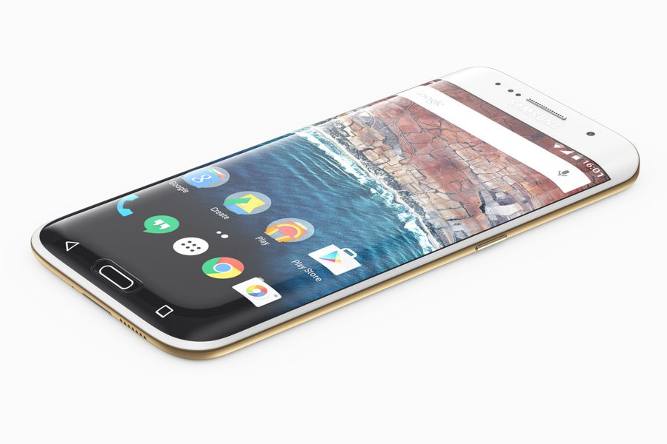
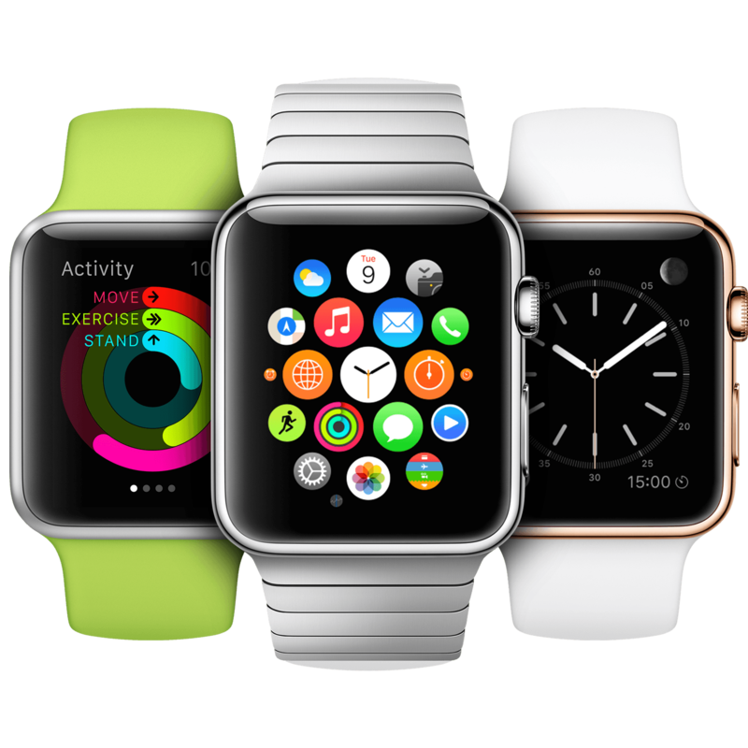
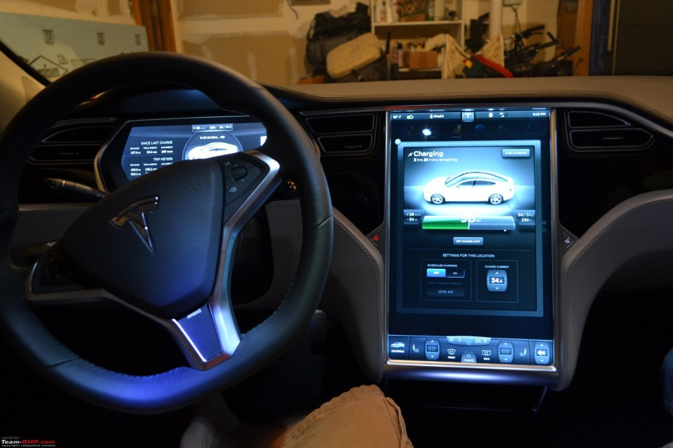
Notes:
The Tabulation Machine Company was consolidated in 1911, along with three other companies, to form computer giant IBM.
Fast forward to today. Computers are in almost everything we touch, from the phone in our pocket to thermostats, refrigerators, cars, and even wrist watches. Just about everything that can be digitized has been attempted, and we are able to connect with people across the world via the internet, or calculate instantly large sums that once took hours by hand. The technological explosion we live in today can thank Jacquard.
With my Honors project application Pattern Partner, the technology-textile crossover comes full circle.
‹#›

Slide 4
The Problem

Slide 5
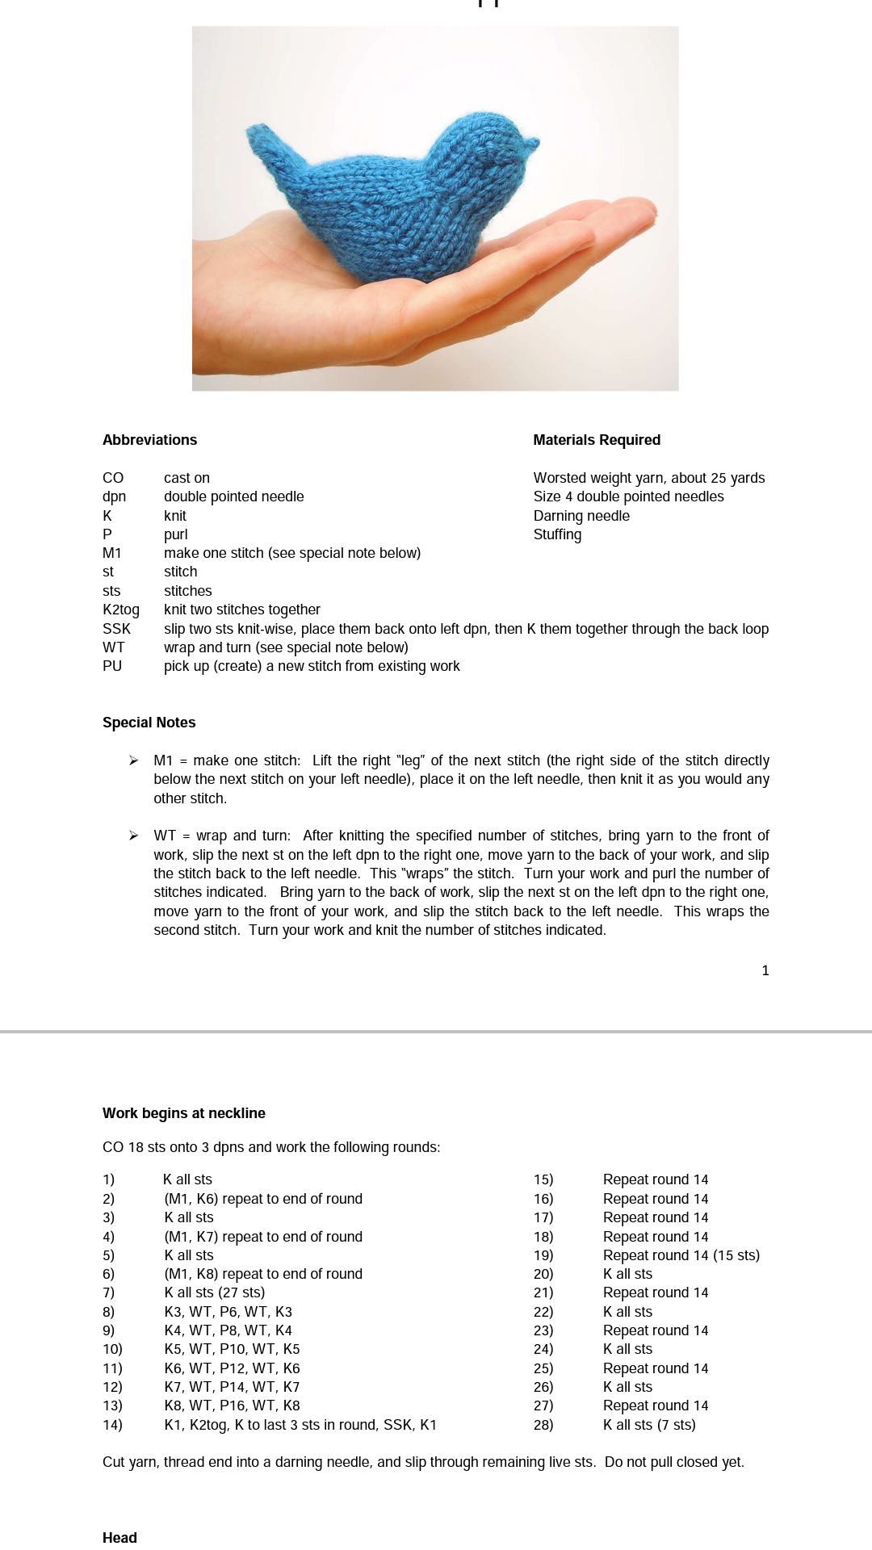
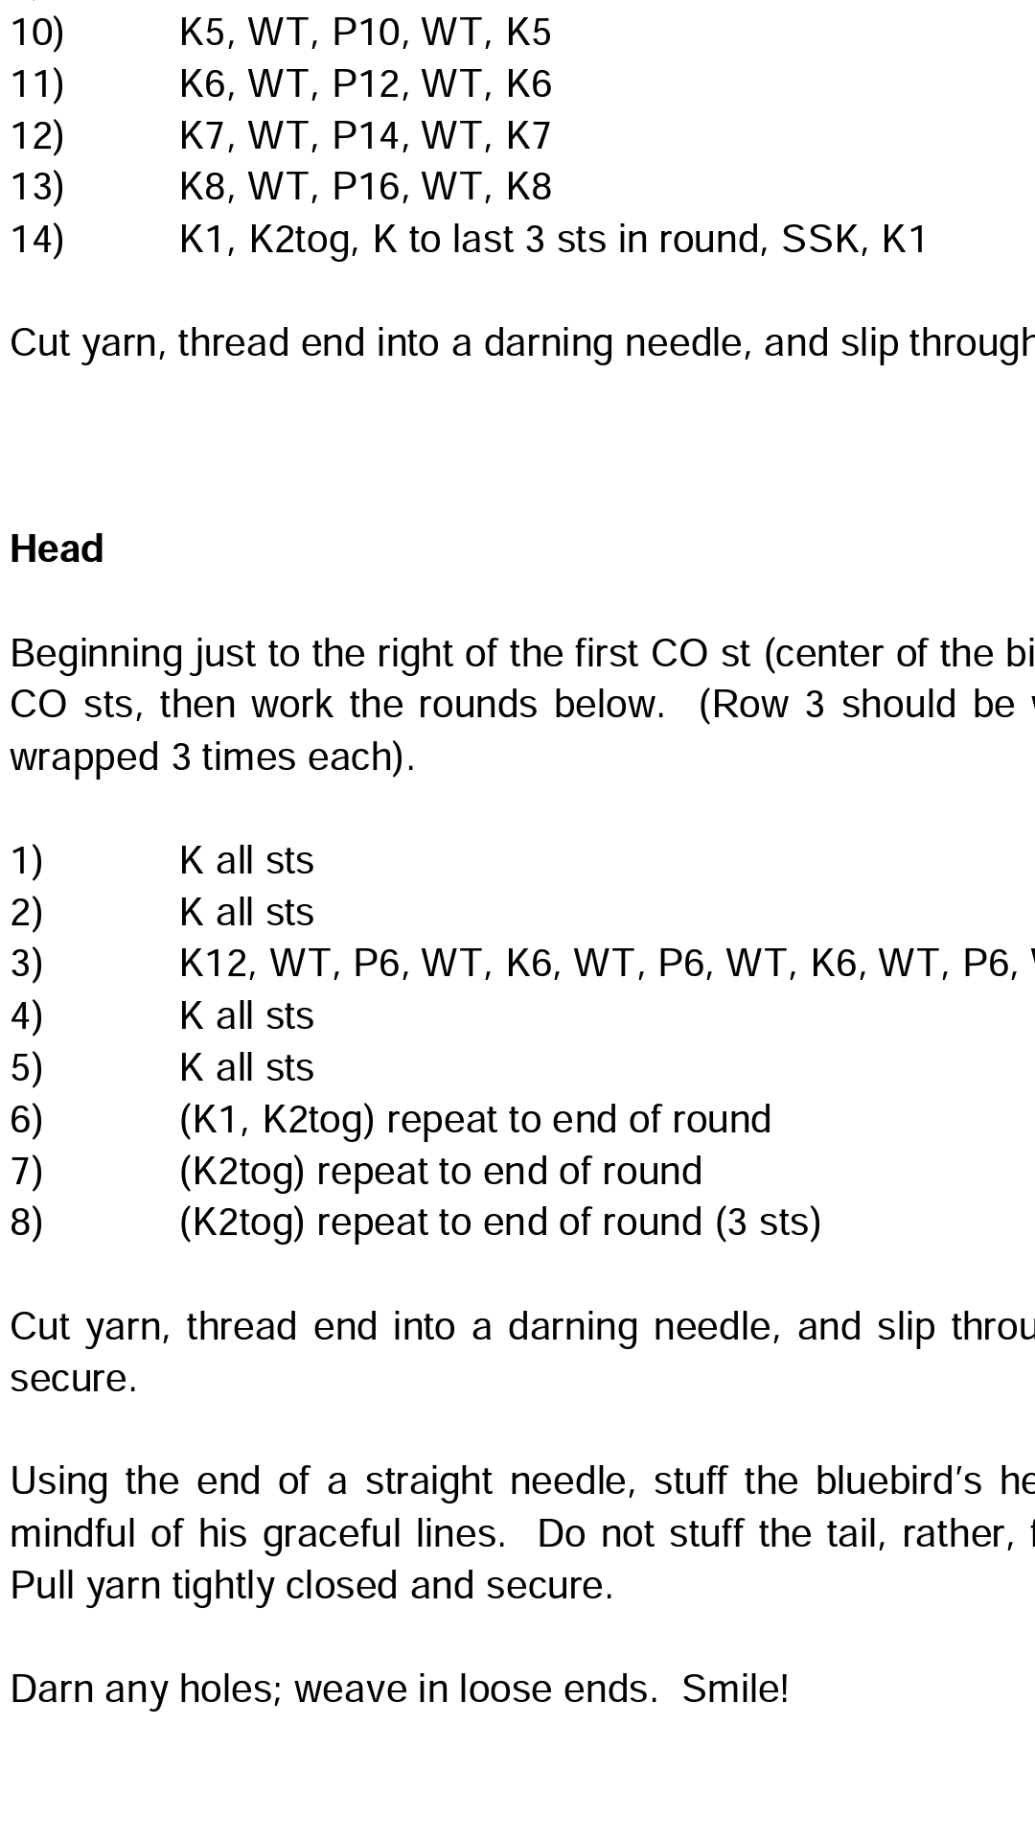
Notes:
Most patterns are uploaded to the internet in the form of PDFs. This makes them readable on almost every device and makes sure the formatting is exactly as the pattern writer wanted it. However phones and PDFs don’t play too well. These are real screenshots from my phone of a pattern I would like to make. On the left is the pattern at 100% zoom. The text is pretty much illegible.
On the right is zoomed into the pattern. Visible, but you have to scroll to see the entire line. This pattern has fairly short lines, but clearly not all of them fit within the screen.
‹#›

Slide 6
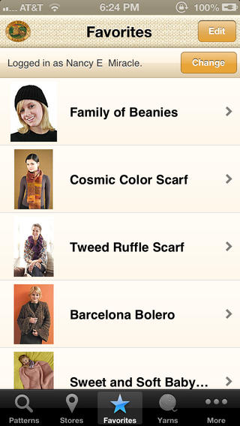
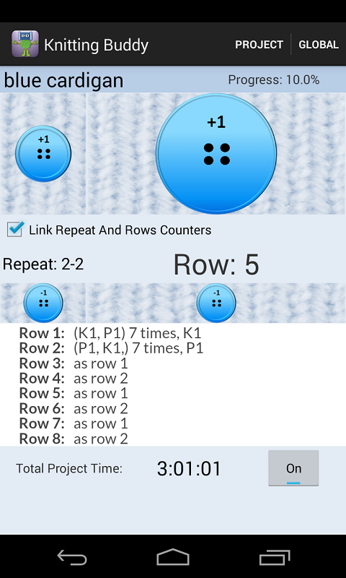
Existing Apps
Lion Brand Yarn
Knitting Buddy
Notes:
Existing apps come in two flavors. On the right, example of pattern library to discover new patterns, but either have to download externally or view pattern but can’t keep track of place
Right, example of keep track of place, usually can’t view the pattern unless you copy-paste or add in a screenshot
‹#›

Slide 7
The Solution

Slide 8
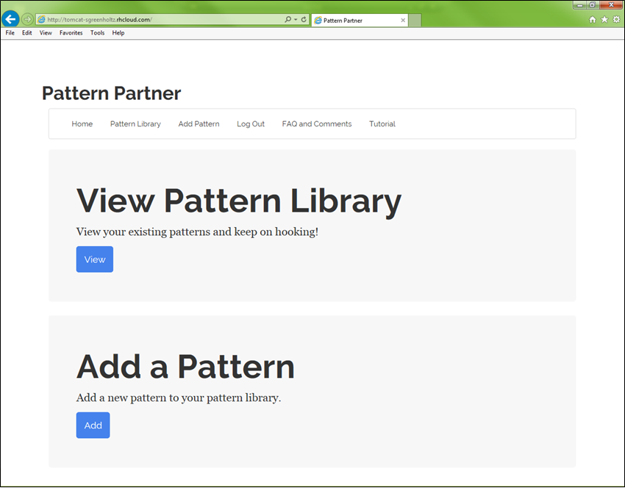
Pattern-partner.com
Notes:
Bridges the gap between the two.
Mobile-ready, easy to use pattern hosting and place tracking site

Slide 9
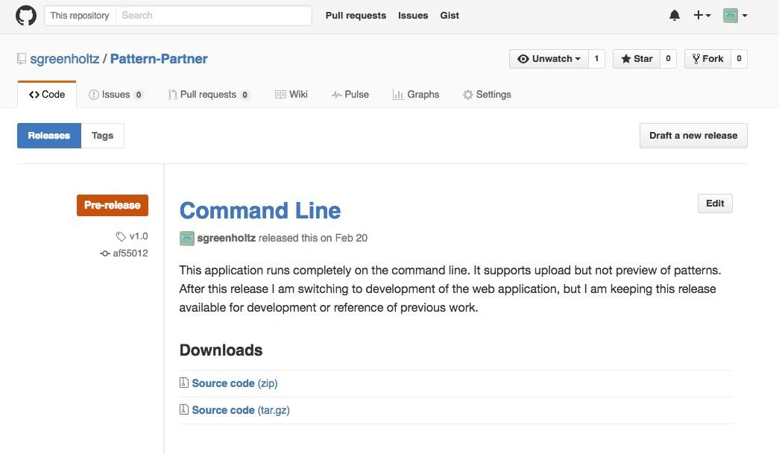
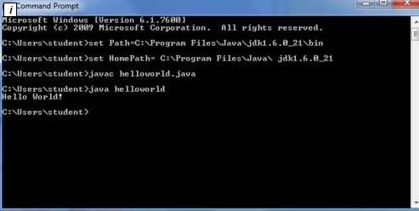
Notes:
First release on the command line. About 24 hours out of 85, 28% of time.
Key commands built: Reading file, uploading to database, displaying pattern

Slide 10
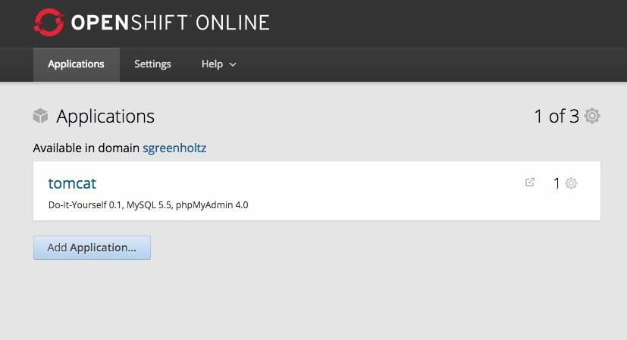
Notes:
Took it to the web
Cloud-based software called OpenShift, which allowed me to build on my computer and push out to the web

Slide 11
Challenges

Slide 12
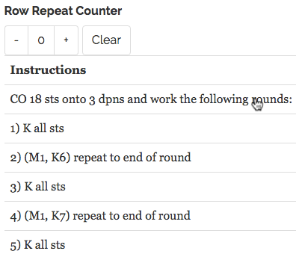
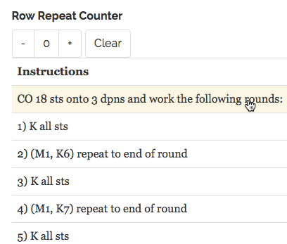
Click to Highlight
Notes:
I spent hours trying to figure out how to keep track of which rows are highlighted from page to page.
Both on the View page and the Add page. I even started teaching myself a new language, AJAX, but ended up abandoning that direction when it proved to be the incorrect method.
In the end, simplest was the best, and I added an invisible form, which keeps track of the row number you click on and sends the data to the next page.

Slide 13
What I Learned

Slide 14
What I Knew In January
Classes and Java Objects
HTML and CSS
How to push to Github
Using the command line to launch an application

Slide 15
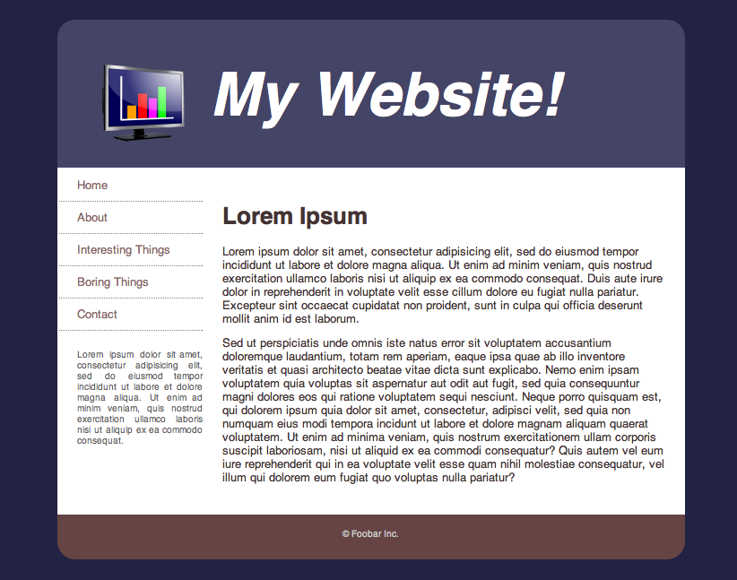

Slide 16
What I Learned By May
Java Server Pages (JSPs)
Servlets and Model View Controller
Deploying an application to Tomcat
Using external libraries
Using a database
Purchasing a domain
Reading and Writing Files
Using properties files
Creating Github repository
Web.xml servlet mapping
Reading Java APIs
Systems design
IT project management

Slide 17
Thank you to Paula Waite,
Honors judges and Julia Haseleu!
pattern-partner.com

